Slide 1
Reducing Chronic Absence:
What Will It Take?
An overview of why it matters and key ingredients for improving student attendance
Spring 2014

Slide 2
Chronic Absence:
A Hidden National Crisis
Nationwide, as many as 10-15% of students (7.5 million) miss nearly a month of school every year. That’s 135 million days of lost time in the classroom.
Missing too much school for any reason effects children’s learning.
Chronic absenteeism is a red alert that students are headed for academic trouble and eventually for dropping out of high school.
Poor attendance isn’t just a problem in high school. It can start as early as kindergarten and pre-kindergarten.

Slide 3
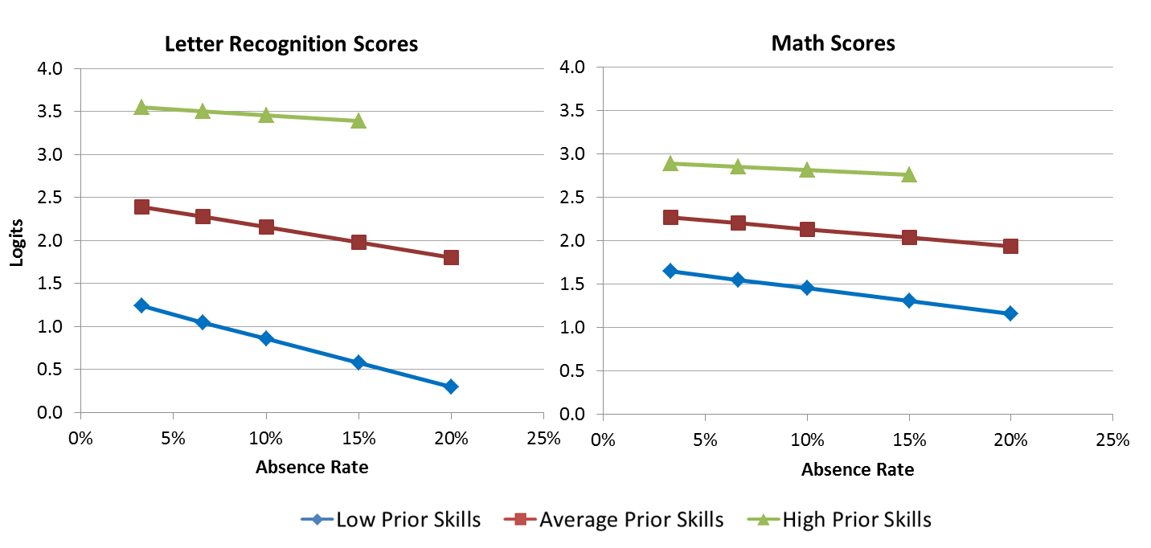
Starting in preK, chronic absence affects learning and school readiness. Attendance matters most for the children who enter the farthest behind.
Analyses control for prior preschool experience, race, gender, neighborhood poverty and social status, special education status, ELL status, and program type. Missing data points represent values with fewer than 30 students.
Notes:
So, children who enter preschool with lower prior knowledge are more likely to be absent more, and the more they are absent, the lower their scores are. You can see this by the steeper slope of the blue curve at the bottom. The kids who need it the most too often get the least….

Slide 4

Key Messages
Key Message #1: Good attendance helps children do well in school and eventually in the work place.

Slide 5
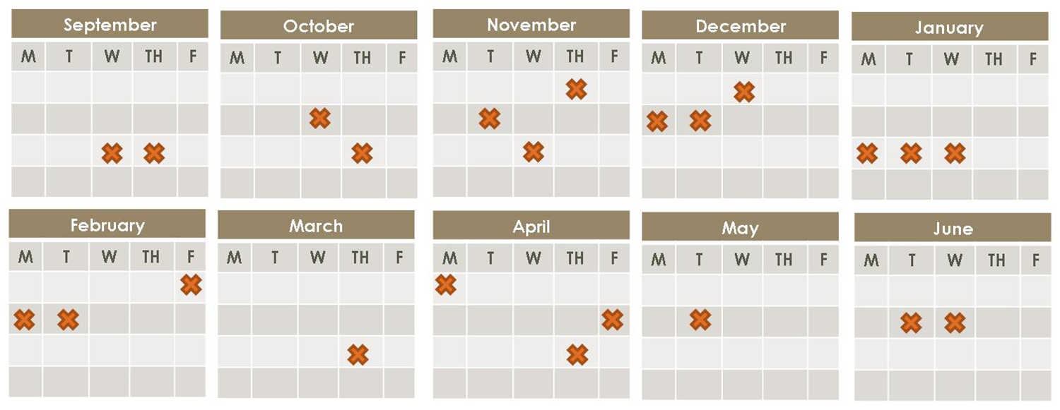
Key Messages
Key Message #2: Absences add up. Excused and unexcused absences result in too much time lost in the classroom.

Slide 6

Key Messages
Key Message #3: Chronic absence is a problem we can solve when the whole community, including parents and schools, gets involved.

Slide 7


Slide 8


